Slide 1

SQL Editor and Parser for
SQLite
By:
Piyush Bhatt
CSE IV Year
GBPEC
Under guidance of:
Mr. Sanjeev Sekhar
Scientist ‘D’
IRDE

Slide 2

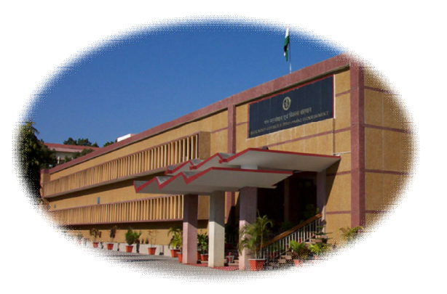
INSTRUMENTS RESEARCH AND DEVELOPMENT ESTABLISHMENT
(IRDE)
BALLISTICS COMPUTER DIVISION

Slide 3
THE
BIG PICTURE

Slide 4
BASICS !!
WHAT IS SQL ???

Slide 5

BASICS !!
WHAT IS

Slide 6









DEFINITION
SQLite is a software library that strives to provide local data storage for individual applications and devices.

Slide 7
“SQL Editor and Parser for
SQLite”
MY SOFTWARE?

Slide 8
FUNCTIONALITIES
AND
FEATURES
GUI
Syntax Highlighting
Syntax Checker
Syntax Hint
Lightweight
Simple to use
Uses SQLite
Atomic Transactions

Slide 9
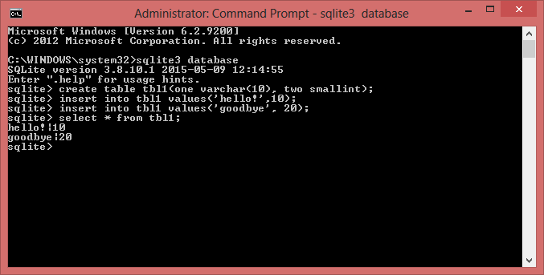
Command Line Provided by SQLite
Commands for creating database and then creating table.

Slide 10
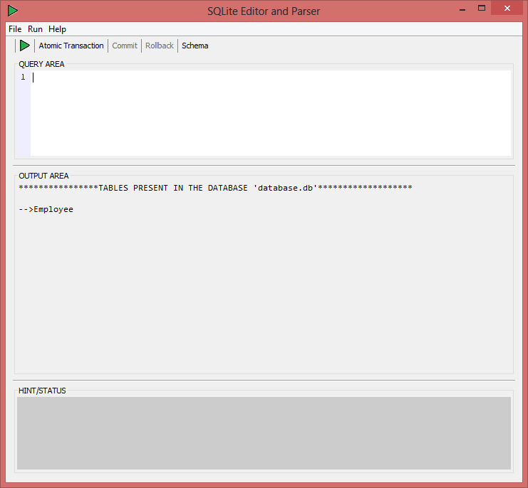
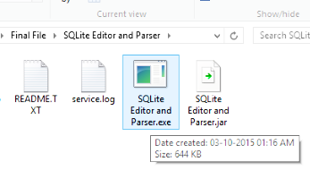
GRAPHICAL USER INTERFACE (GUI)

Slide 11
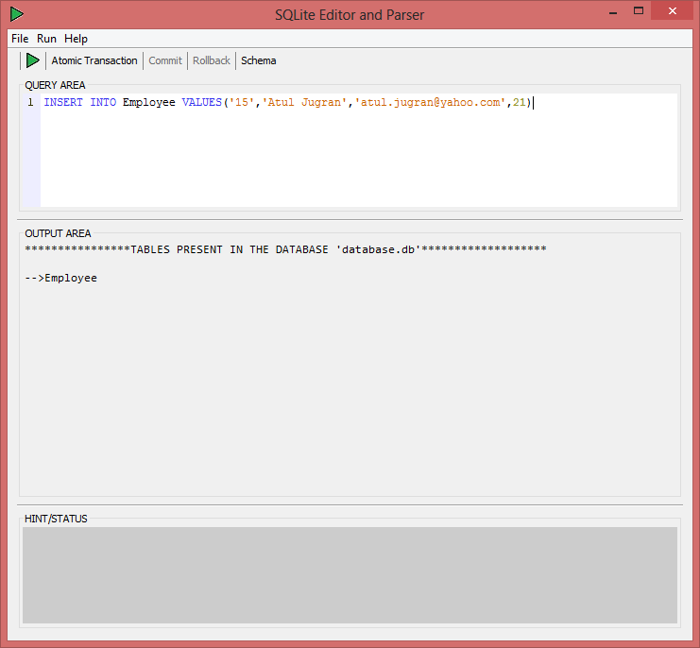
Syntax Highlighting

Slide 12

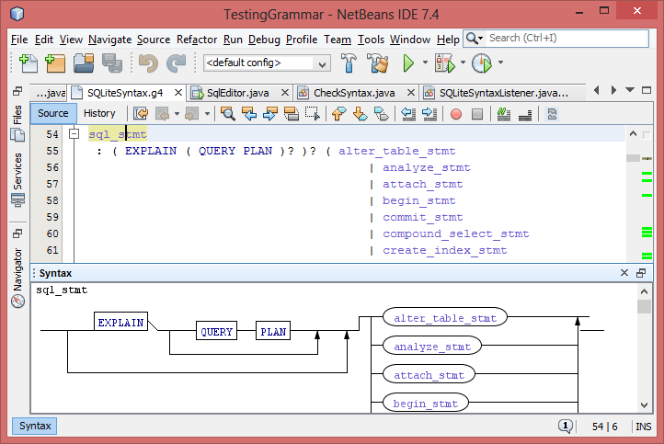
Syntax Checker
Parser
Generator
used:

Slide 13
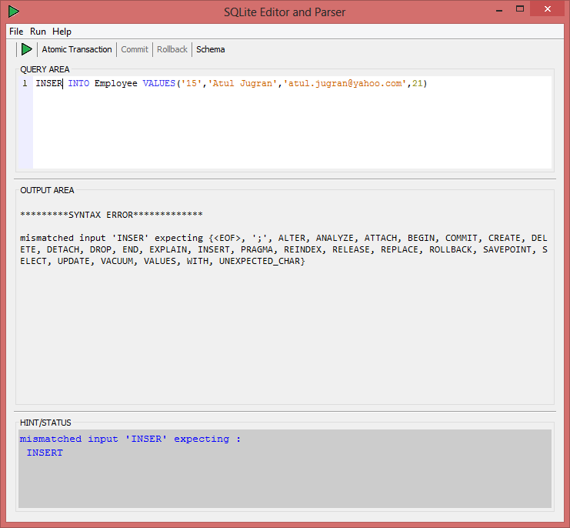
Syntax Hint
Syntax error
Syntax
hint

Slide 14
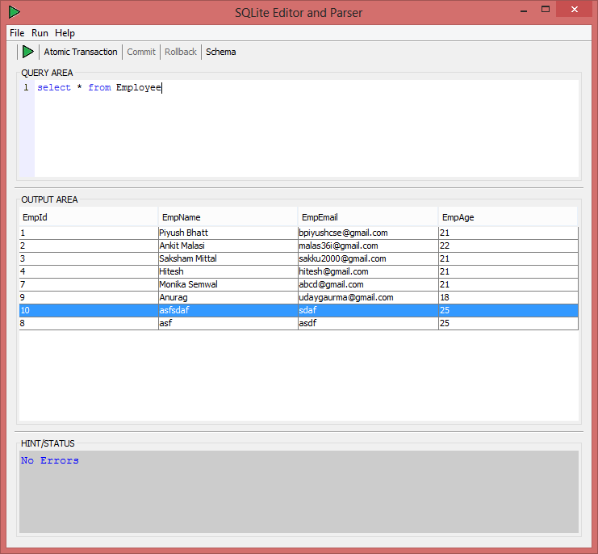
Atomic Transactions

Slide 15
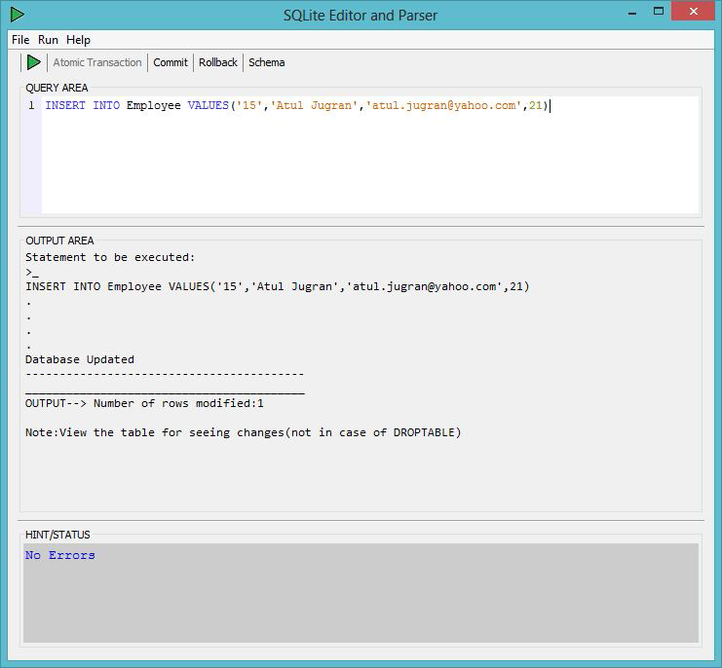
Atomic Transactions
ACTIVATED

Slide 16
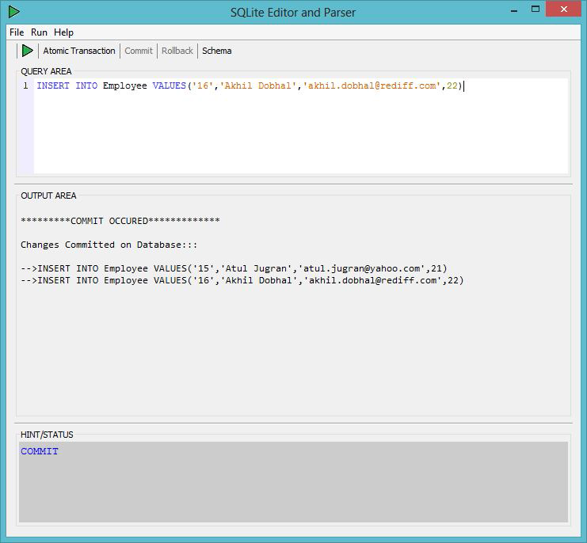
Atomic Transactions
COMMIT

Slide 17
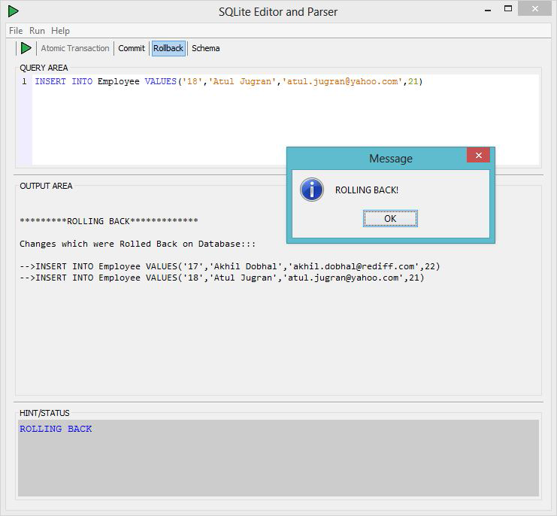
Atomic Transactions
ROLLBACK

Slide 18
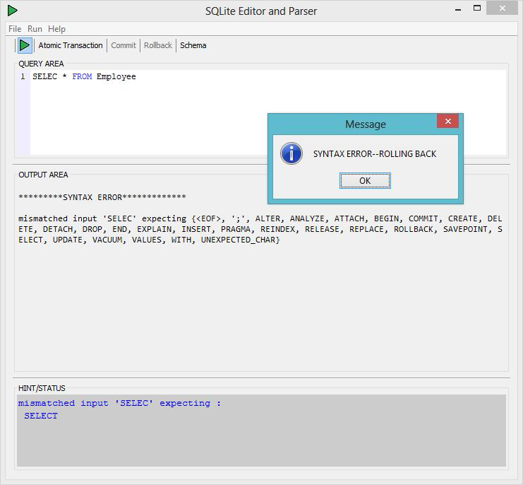
Atomic Transactions

Slide 19
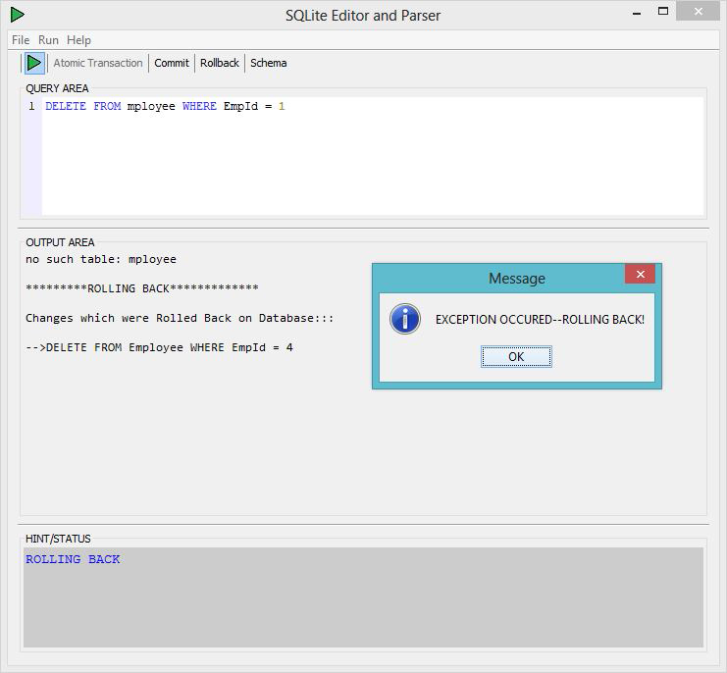
Atomic Transactions

Slide 20
THANK
YOU

